Slide 1
Does Home Field Advantage Really Exist in the NFL?
Srihan, Mestere

Slide 2
Hypothesis
Srihan
Null Hypothesis: The number of home wins is independent of homefield advantage, indicating no significant correlation between the number of home wins and the overall performance of home teams compared to away teams.
There is a positive correlation between winning games and having home-field advantage.
Alternative Hypothesis: There is a negative correlation between winning games and having home-field advantage.

Slide 3
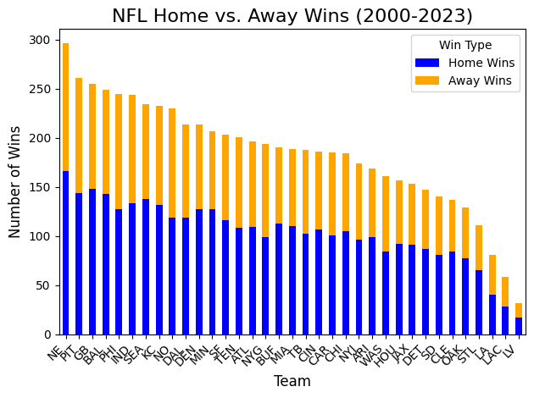
Bar Graph
Srihan
Graph shows the amount of home and away games each team has won since 2000.
This graph tells us that home field advantage will increase the home teams chances of winning.

Slide 4
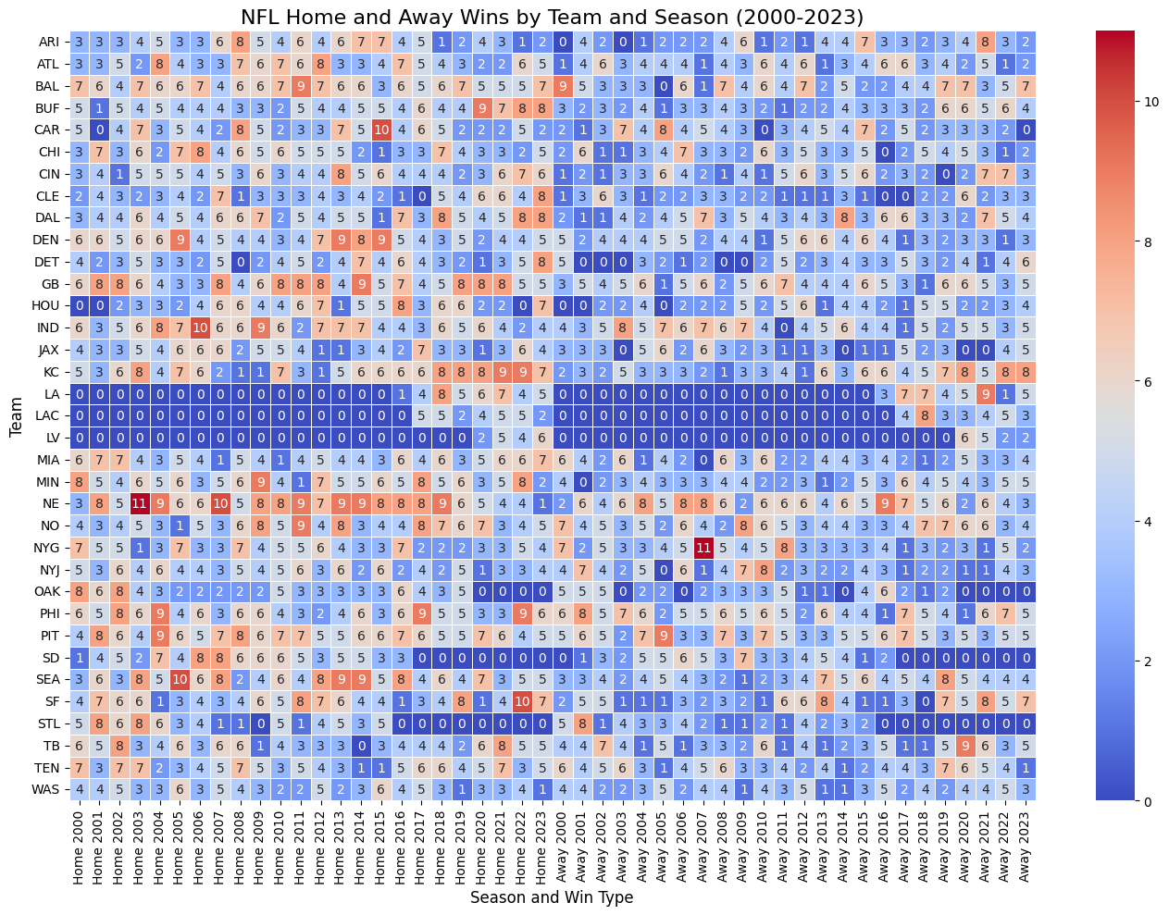
Heat Map
Mestere
Higher home wins are reflected in red areas
Teams with both home and away wins are in light colors
Teams that struggled to win home and away games are reflected in blue areas

Slide 5
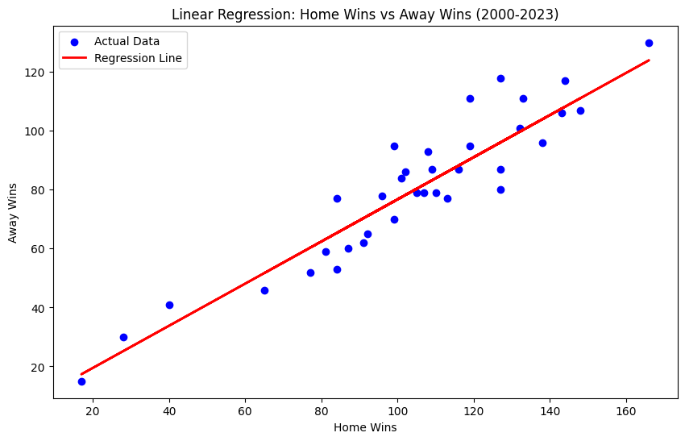
Linear Regression
Mestere
Each dot represents each teams total home and away wins
Root Mean Squared Error: 10.25
R-squared: 0.67

Slide 6
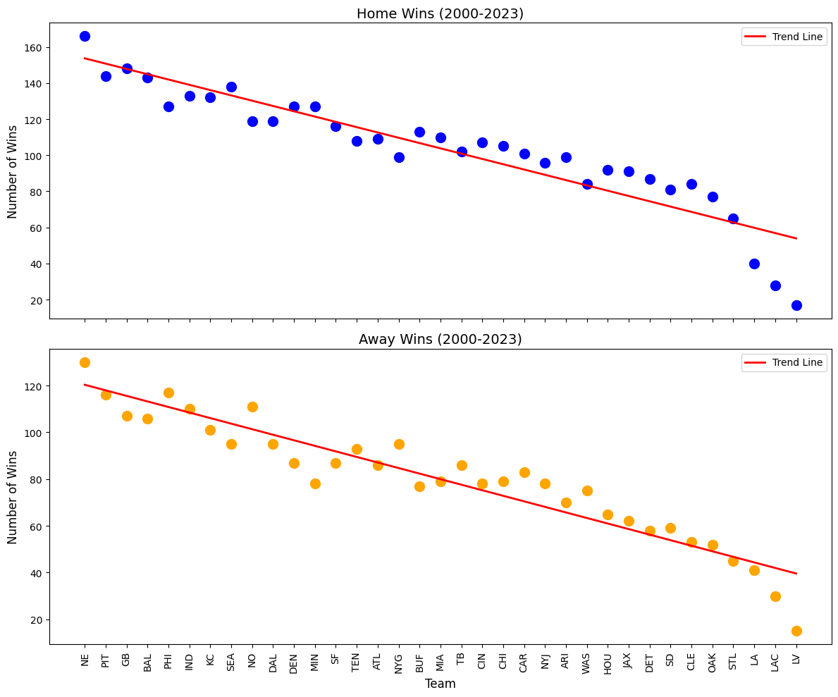
Dot Plot Subplot
Mestere
Home team has a higher overall win rate than away teams
Steeper decline for away wins
Consistent home advantage across teams

Slide 7
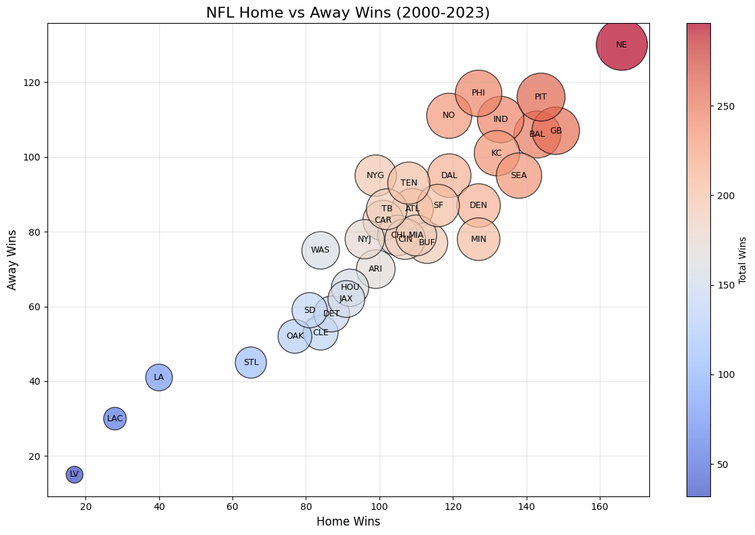
Bubble Chart
Srihan
Here, it is evident that there is a positive correlation towards home team advantage
The bigger the bubble, the more wins a team has overall.
The smaller the bubble, the less wins a team will have

